Slide 1
CS209: Computer Science II

Slide 2
Unit 3 Module 1:
Algorithms
Introducing Generic Algorithms
Running Times and Big-O Notation
Asymptotic Analysis
Container Access Times
Generic Algorithm Classification

Slide 3
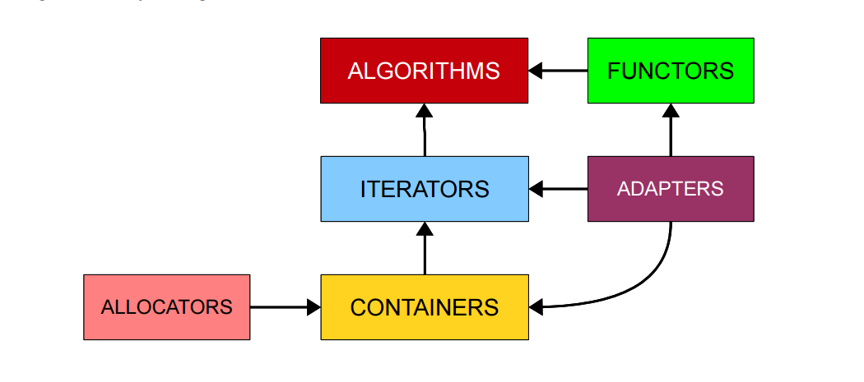
Algorithms
YOU ARE HERE

Slide 4
Generic Algorithms
“Generic Algorithm” are a template functions that use iterators as template parameters.
This chapter will use Generic Algorithm, Generic function, and STL function template to mean the same thing.
Function interface specifies task, minimum strength of iterator arguments, and provides run-time specification.

Slide 5
Generic Algorithms
The STL is implemented concisely. The algorithms are separated from the containers and operate on elements of the containers only indirectly through iterators. This separation makes it easier to write generic algorithms applicable to many container classes.
STL algorithms can operate on STL containers and on pointer-based, C-like arrays.
Because STL algorithms process containers only indirectly through iterators, one algorithm can often be used with many different containers.

Slide 6
Running Times and Big-O Notation
To be useful, running times for an algorithm must specify time as a function of the problem size.
We can time a program with a stop watch or instrument the code with calls to the system clock to empirically determine running time.
What problems do you see there?
There is a better way.

Slide 7
Worst case running time
In the rest of the chapter we will always mean “worst case running time” when we specify a running time.
How do we proceed? Do we count “steps” or “operations”?
What is a step? What is an operation?
Disagreement abounds, but mostly we agree to count =, <, &&, !, [ ], ==, and ++
This simplifying assumption works well in practice.

Slide 8
Objections
We need a way to measure more than a programs run time.
We need to consider some factors, but not all but not ignore some operations that might be significant.
Not all operations take the same time.
We want to know how much main memory, the time required, and the space required for the data structure.
A given operation takes different time on different machines.
What we are really interested in is the growth rate of the running time as a function of the problem size, not precise computations for a particular architecture.

Slide 9
Asymptotic Analysis
In general, we will always analyze algorithms with respect to one or more variables
We will begin with one variable:
The number of items n currently stored in an array or other data structure
The number of items expected to be stored in an array or other data structure
The dimensions of an n × n matrix
Examples with multiple variables:
Dealing with n objects stored in m memory locations
Multiplying a k × m and an m × n matrix
Dealing with sparse matrices of size n × n with m non-zero entries

Slide 10
Asymptotic Analysis
Given an algorithm:
We need to be able to describe these values mathematically
We need a systematic means of using the description of the algorithm together with the properties of an associated data structure
We need to do this in a machine-independent way
T(n) = x(n)
This equation describes the growth rate for the running time of our algorithm.

Slide 11
An example
int i = 0;
bool found = false;
while (( i < N ) && !(found))
if (a[i] == target)
found = true;
else
++i;
Assume target is not in array.
Loop runs N times, 6 operations per iteration. <, &&, ! , [i] , ==, ++
After N iterations, boolean expression adds 3 operations, <, &&, and !
Total of 6N + 3 operations.

Slide 12
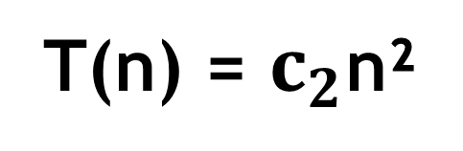

Asymptotic Analysis
Consider:
sum = 0;
for (i=1; i<=n; i++)
for (j=1; j<=n; j++)
sum++;
T(n)
$$c_{2}$$
T(n) = $c_{2}$n²

Slide 13
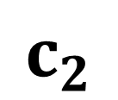
Asymptotic Analysis
Consider:
sum = 0;
for (i=1; i<=n; i++)
for (j=1; j<=n; j++)
sum++;
$$c_{2}$$
Primitive operations?

Slide 14
Asymptotic Analysis
Consider:
sum = 0;
for (i=1; i<=n; i++)
for (j=1; j<=n; j++)
sum++;
3 constant operations
5 repeated operations
3 + 5(n) steps
$$c_{2}$$
Primitive operations?

Slide 15
Big O
Big-O Notation
Analysis of Algorithms
(how fast does an algorithm grow with respect to N)
Use O, order
(the growth rate of the running time as a function of the problem size)
Other bounds for asymptotic growth rates - Ω Θ ω

Slide 16
Big O
O(1) - constant time
This means that the algorithm requires the same fixed number
of steps regardless of the size of the task.
Examples (assuming a reasonable implementation of the task):
Push and Pop operations for a stack (containing n elements);
B. Insert and Remove operations for a queue.

Slide 17
Big O
O(log n) - logarithmic time
Examples:
Binary search in a sorted list of n elements;
B. Insert and Find operations for a binary search tree with n nodes;
C. Insert and Remove operations for a heap with n nodes.

Slide 18
Big O
O(n) - linear time
This means that the algorithm requires a number of steps proportional
to the size of the task.
Examples (assuming a reasonable implementation of the task):
Traversal of a list (a linked list or an array) with n elements;
B. Finding the maximum or minimum element in a list, or sequential search in an unsorted list of n elements;
C. Traversal of a tree with n nodes;
D. Calculating iteratively n-factorial; finding iteratively
the nth Fibonacci number.

Slide 19
Big O
O(n log n) – “n log n” time
Examples:
A. More advanced sorting algorithms; quicksort and merge sort;

Slide 20
Big O
O(n²) - quadratic time
The number of operations is proportional to the size of the task squared.
Examples:
Some more simplistic sorting algorithms, for instance
a selection sort of n elements;
B. Comparing two two-dimensional arrays of size n by n;
C. Finding duplicates in an unsorted list of n elements
(implemented with two nested loops).

Slide 21
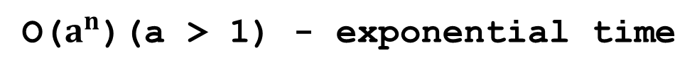
Big O
O($a^{n}$)(a > 1) - exponential time
The Examples:
Recursive Fibonacci implementation
B. Towers of Hanoi
C. Generating all permutations of n symbols

Slide 22
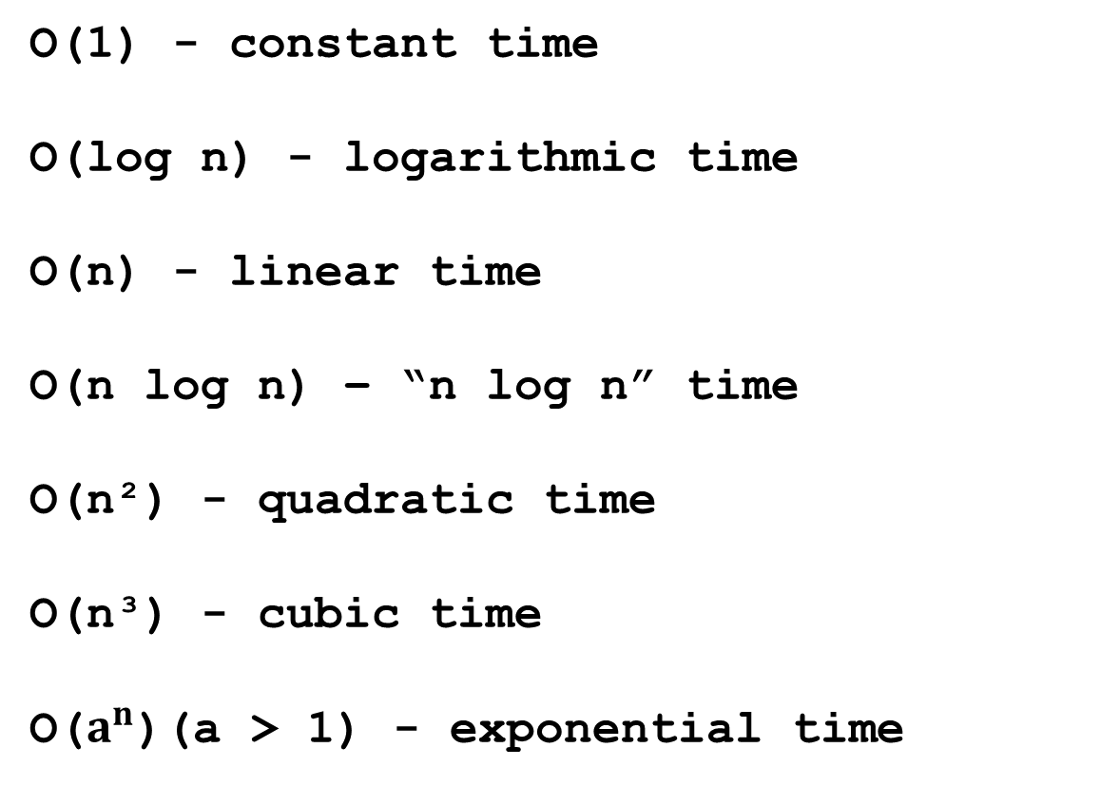
Big O – order of the order of
O(1) - constant time
O(log n) - logarithmic time
O(n) - linear time
O(n log n) – “n log n” time
O(n²) - quadratic time
O(n³) - cubic time
O($a^{n}$)(a > 1) - exponential time
O(1) < O(log n) < O(n) < O(n log n) < O(n²) < O(n³) < O($a^{n}$)

Slide 23
Large Coefficients Do Not Matter
Big-O estimates do not distinguish 5N + 5 and 100N
These all have Big-O estimates of O(N³)
N³ + 4000N² – N + 1
8N³ + 5N – 1000
1000N³ + 4N² – 100000N + 1
Regardless of the coefficient, the largest exponent “rules”

Slide 24
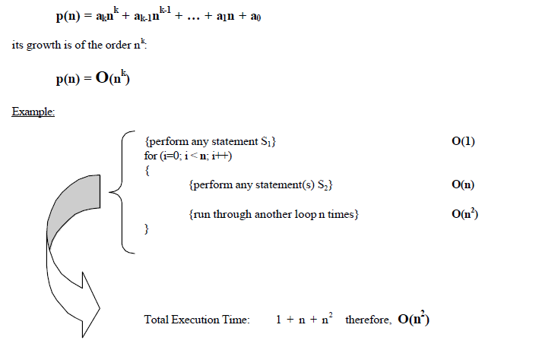
Big O – most dominant term is it!

Slide 25
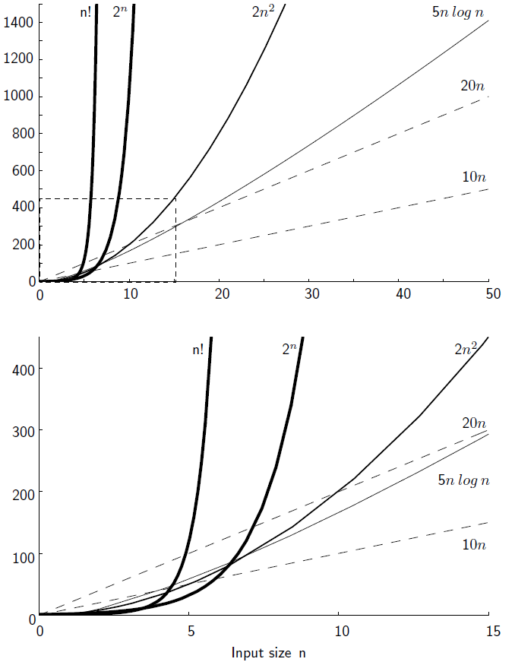
Asymptotic Analysis

Slide 26
Asymptotic Analysis

Slide 27
Asymptotic Analysis

Slide 28
Asymptotic Analysis

Slide 29
Asymptotic Analysis

Slide 30

Asymptotic Analysis
int find_max( int *array, int n , int k)
{
for ( int i = 1; i < n; ++i )
{
if ( array[i] == k )
{
return k;
}
}
return -1;
}
n – total elements
k – search value

Slide 31
Asymptotic Analysis
Bigger is better… Let’s buy a bigger box
- ten times faster.
How’s my algorithm’s time now?
It’s ten times faster, right?

Slide 32
Asymptotic Analysis
Asymptotic
- Ignores run time constants
- Studies input size or limits
- Is simplified
- Has limitations

Slide 33
Asymptotic Analysis
Upper bounds
- The highest growth rate of an algorithm
- Worse case upper bound for an algorithm's
growth rate (the worst case) is n²
- Big O notation is O(n²)

Slide 34
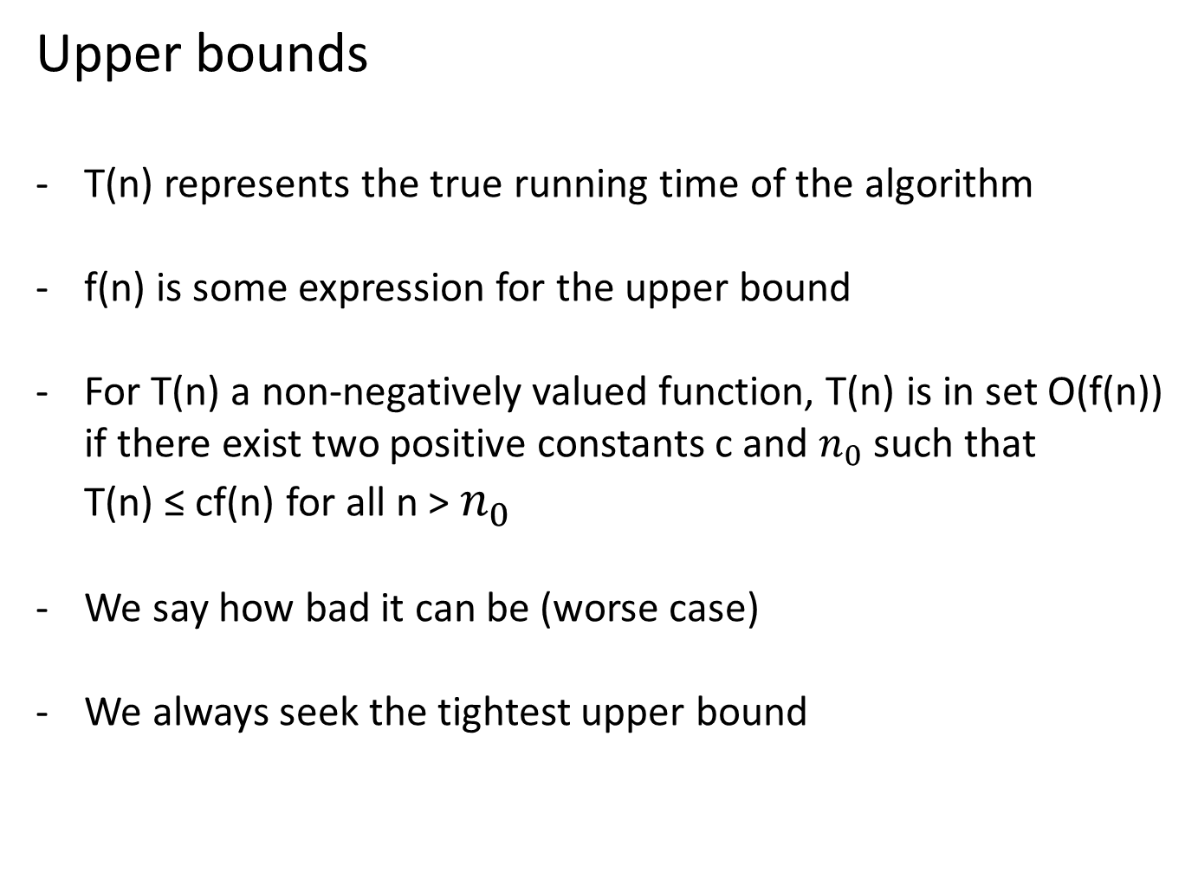
Asymptotic Analysis
Upper bounds
T(n) represents the true running time of the algorithm
f(n) is some expression for the upper bound
For T(n) a non-negatively valued function, T(n) is in set O(f(n))
if there exist two positive constants c and $n_{0}$ such that
T(n) ≤ cf(n) for all n > $n_{0}$
We say how bad it can be (worse case)
We always seek the tightest upper bound

Slide 35
Asymptotic Analysis
Consider:
sum = 0;
for (k=0; k<=n; k++)
for (j=0; j<=k; j++)
sum++;
Calculating run time for programs

Slide 36
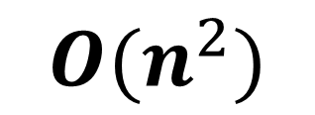
Asymptotic Analysis
Consider:
sum = 0;
for (k=0; k<=n; k++)
for (j=0; j<=k; j++)
sum++;
$$O(n^{2})$$
Calculating run time for programs
cost of the loop = the constant operations (k, j, sum++) times the sum of (0 thru n)

Slide 37
Container Access Times
Now that we know all that, let’s look at the guaranteed runtimes of some of the more common Algorithms.
Remember, STL algorithms can be used generically across a variety of containers.
The STL is extensible. It’s straightforward to add new algorithms and to do so without changes to STL containers.
We will use them frequently to manipulate containers. Having empirical runtime guaranteed makes choosing easier.

Slide 38
Container Access Time 1
vector: push_back(el), pop_back( ) have O(1) (constant upper bound) running time
deque: push_back(el), push_front(el), pop_back( ), push_back(el) are all O(1)
list: insert anywhere is O(1)
Finding the location of an element in a list has O(N) running time.

Slide 39
Container Access Time 2
vector, deque insert in the middle is O(N)
vector insert at the front is O(N)
Most set and map operations are O(log N) Other set and map operations are O(1).

Slide 40
Generic Algorithm Classification
Algorithms are classified into
Nonmodifying Sequence Algorithms
Modifying Sequence Algorithms
Sorting and Related Algorithms
Numeric Algorithms
Removal Algorithms
Mutating Algorithms
Sorted Range Algorithms

Slide 41
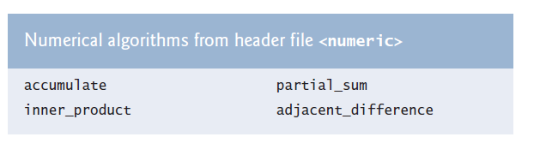
Numerical Algorithms <numeric>
A set of algorithms to perform certain operations on sequences of numeric values
Function templates

Slide 42
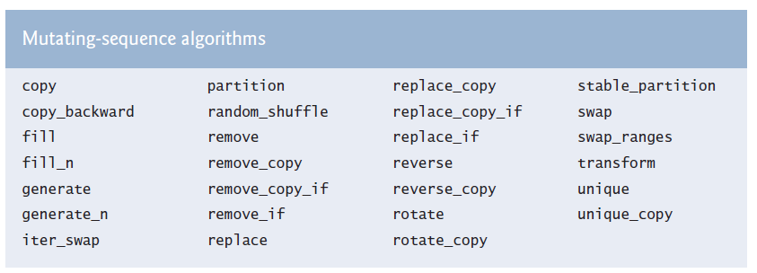
Mutating Sequence Algorithms
These are modifying algorithms, but they are designed specifically to modify the order of elements (e.g. a random shuffle or rotation).

Slide 43
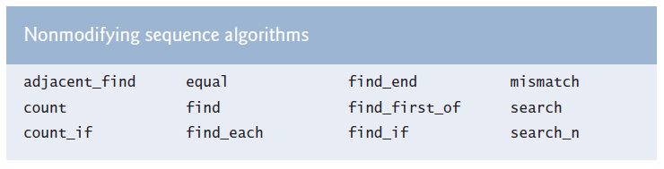
Nonmodifying Sequence Algorithms
Nonmodifying algorithms that do not modify the container they operate upon.

Slide 44
Nonmodifying Sequence Algorithms
The declaration of the generic function find algorithm:
template<class InputIterator, class T> InputIterator find (InputIterator first,
InputIterator last, const T& value);
The declaration tells us find works with any container that provides an iterator at least as strong as an input iterator.
Type T objects must be equality comparable.

Slide 45
Iter find(Iter first, Iter last, const T& value);
The generic algorithm find( ) locates an element within a sequence. It takes three arguments.
The first two specify a range: [start, end), the third specifies a target value for the search.
If requested value is found, find( ) returns an iterator that points to the first element that is identical to the sought-after value.
If the requested value is not found, find( ) returns an iterator pointing one element past the final element in the sequence (that is, it returns the same value as end( ) does).

Slide 46
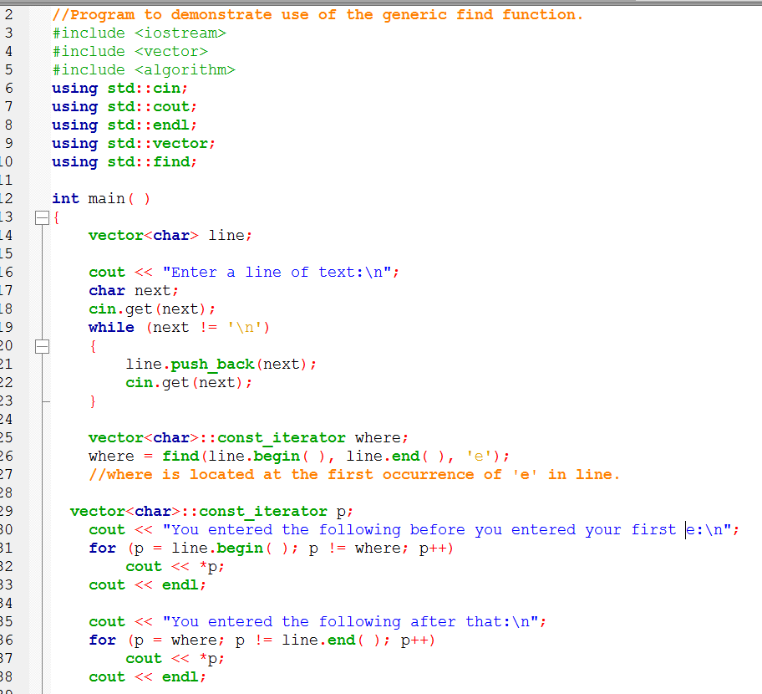
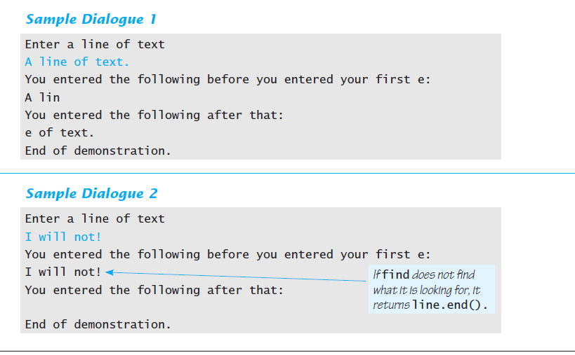
Need to include these two
If the find does not find what we asked it to, it returns the second argument
First pass go up to the ‘e’
Second pass through picks it up from there, and goes to the ‘end’

Slide 47
More nonmodifying Algorithms
count Counts occurrences of a value in a sequence
equal Asks are elements in two ranges equal?
search Looks for the first occurrence of a match sequence within another sequence
binary_search Searches for a value in a container sorted using less. If the container was sorted using another predicate, this predicate must be supplied to binary_search. This is an efficient search for sorted sequences with random access iterators.

Slide 48
Container Modifying Algorithms
Container modifying algorithms change the content of the elements or their order.
copy Copies from a source range to a destination range. This can be used to shift elements in a container to the left provided that the first element in the source range is not contained in the destination range.
remove Removes all elements from a range equal to the given value
random_shuffle shuffles the elements of a sequence. Argument 1 is an iterator pointing to the first of the sequence. Argument 2 points one position past the last element of the sequence.

Slide 49
Sorting Algorithms
Algorithm analysis tells us that the runtime of the most efficient sort algorithms that depend on swapping elements is O(N log(N)). N is the number of elements being sorted.
All the STL sorting algorithms are required to be O(N log(N)), so these algorithms (up to a multiplicative constant) as fast as possible.
sort Sorts elements in a range in nondescending order, or in an order determined by a user-specified binary predicate.
merge Merges two sorted source ranges into a single destination range.

Slide 50
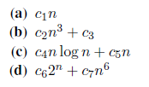
Practice
Using the definitions below of big-O, find the
upper bounds for the expressions:

Slide 51
Practice
Other values for n0 and c are possible than what is given here

Slide 52
Chapter Summary 1
An iterator is a generalization of pointer. Iterators allow cycling through containers without compromising the container structure.
Most iterators have operations ++ and dereferencing * defined.
Main kinds of iterators are:
Forward, where ++ works but -- does not
Bidirectional where ++ and -- work
Random access where ++ -- indexing and iterator arithmetic all work.

Slide 53
Chapter Summary 2
Kinds of container classes are
Sequence containers: vector, deque, list
Adapters: stack, queue, priority queue
Deque is the default underlying container
User can select an underlying container
Stack discipline is last-in-first-out
Queue discipline is first-in-first-out
Priority queue keeps largest key on top.

Slide 54
Chapter Summary 3
Associative containers: set, map, multiset, multimap
Associative containers store elements in sorted order
Map is a set of <key, value> pairs, allowing retrieval on key.
Multiset and multiset allow single key for multiple entries

Slide 55
Chapter Summary 4
Containers with iterators also provide member functions begin( ) and end( ) that return iterator types useful to traverse the container:
for (p = c.begin( ); p != c.end( ); p++)
process(*p ); // *p is the current item
Dereferencing a constant iterator *const_p provides read only access.
Dereferencing a mutable iterator produces a read-write access: *mutable_p

Slide 56
Chapter Summary 5
The sequence container list provides mutable bidirectional iterators.
The sequence containers vector and deque provides mutable random access iterators.
The STL provides template functions (sometimes called generic algorithms or template functions) that provide very guarantees on maximum running time.

Slide 57
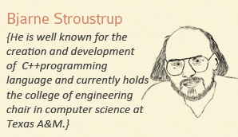
STL algorithms save time and guarantee performance too.

Slide 58
References
Slide contributions include:
Walter Savitch, Problem solving with C++ (9th Edition). Addison-Wesley Longman Publishing Co., Inc. Boston, MA, USA ©2015
Gaddis, Starting Out with C++: From Control Structures through Objects, (8th Ed.) , Addison-Wesley Longman Publishing Co., Inc. Boston, MA, USA ©2015
Bjarne Stroustrup, The C++ Programming Language, 3rd Edition, Addison-Wesley Longman Publishing Co., Inc. Boston, MA, USA ©2007
Herb Sutter, Andrei Alexandrescu, C++ coding standards : 101 rules, guidelines, and best practices, Copyright © 2005 Pearson Education, Inc.
Paul Deitel & Harvey Deitel, C++ How to Program, (7th Ed.) © 2010 by Pearson Education, Inc.
Upper Saddle River, New Jersey 07458
Scott Meyers, Effective Modern C++. Copyright © 2015 (O’Reilly) , 978-1-491-90399-5.
Andrew Koenig and Barbara E. Moo, Accelerated C++ Practical Programming by Example,
Addison-Wesley, 2000 ISBN 0-201-70353-X

Slide 59
References
Slide contributions include:
Frank M. Carrano. Data Abstraction & Problem Solving with C++ (5th Edition)
Addison-Wesley Longman Publishing Co., Inc. Boston, MA, USA ©2006
TutorialsPoint - http://www.tutorialspoint.com/cplusplus/
Cplusplus.com - http://www.cplusplus.com/doc/tutorial/
http://www.keithschwarz.com/cs106l/fall2010/course-reader/Ch5_STLSequenceContainers.pdf

